Slide 1


CSE 455 Software Testing
Lecture 7
This course is offered to the students of students of BS Software Engineering who are enrolled in 8th semester

Slide 2
Course instructor Yella mehroze
yellamehroze@cuilahore.edu.pk

Slide 3

Compatibility Testing

Slide 4
Introduction
Compatibility Testing Objectives
Compatibility Testing Background
Compatibility Testing Overview
Platform and Application Version
Backward and Forward Compatibility
Impact of Testing Multiple Versions
Standards and Guidelines
High Level Standards
Low Level Standards
Data Sharing Compatibility

Slide 5
Compatibility Testing Objectives
To ensure that the software is meeting the business and user requirements and is optimized for quality
To check the application working in the same way for all platforms
To ensure reduction of future help desk costs which are incurred on providing customer support for compatibility issue

Slide 6
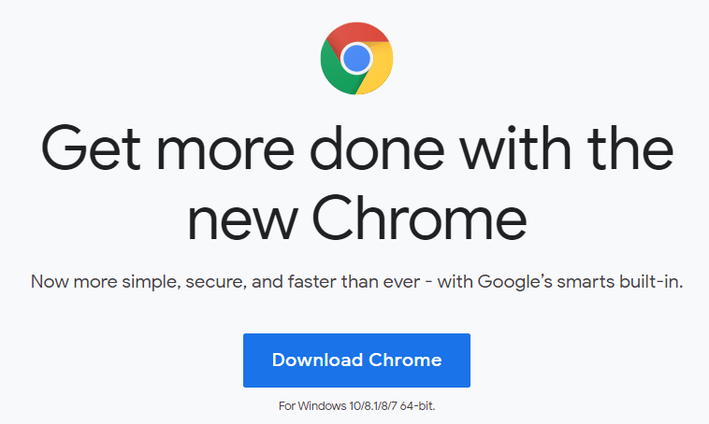
Compatibility Testing Background
Programs used to be developed as a stand-alone application
Those programs would be run in a known, understood environment, isolated from anything that could corrupt it.
Today programs need to import and export data to other programs
Programs run with different operating systems
and web browsers and interoperate with other
software running on the same hardware
Software compatibility ensures that this
interaction works as user would expect
Notes:
Point 4 Example: Google chrome is available for windows and MAC operating system separately. You can see in the picture the google chrome can be downloaded for windows 10, 8.1, 8 and 7 64 bit version.

Slide 7
Compatibility Testing Overview
Software compatibility testing means checking that your software interacts with and shares information correctly with other software
Interaction can occur between programs:
Running simultaneously on the same computer
Running on different computers connected through internet thousands of miles apart
Notes:
For example, if Google.com site is compatible, then it should open in all browsers and operating system.

Slide 8
Compatibility Testing Overview
Examples of compatible software
Cutting text from a web page and pasting it into a document opened in your word processor
Saving accounting data from one spreadsheet program and then loading it into a completely different spreadsheet
Having photograph touchup software work correctly on different versions of the same operating system
Upgrading to a new database program and having all your existing databases load in and work just as they did with the old program
Notes:
Cutting text from a web page and pasting it into a document opened in your word processor
For example: When you make your assignments you copy content from different sites and paste it into the word processor like Microsoft word. It means Microsoft word has no compatibility issues with the text or graphics available in the browser otherwise you would not have been able to make your assignments.
Having photograph touchup software work correctly on different versions of the same operating system
You can edit your pictures in both the online photo editing tools available or you can download different tools and edit your pictures. These tools support different formats of the pictures and you can also save edited pictures in different formats. For example JPEG, PNG etc.
Upgrading to a new database program and having all your existing databases load in and work just as they did with the old program
If a database file created in the old version of wamp server cannot open/load properly in the latest version of wamp server, then the wamp server will not be a choice for many users.
Similarly, If your product cannot not run on different versions of the operating system and doesn't support different versions of other soft wares it will be difficult for it to survive in the market.

Slide 9
Compatibility Testing Overview
Levels of Compatibility
No Compatibility Considerations
Multitude of Compatibility Considerations
Example: Software for Medical Device
Example: Word Processor
Notes:
Example: Software for Medical Device
If Software is for a standalone medical device. The device runs its own operating system, stores its data on its own memory cartridges and does not connect to any other device then it will require no compatibility considerations.
Example: Word Processor
The word processor reads and writes different files from other word processors. It allows multiuser editing over the internet, supports inclusion of embedded pictures and spreadsheets from various applications. So it will have multitude of compatibility considerations.

Slide 10
Compatibility Testing Overview
To perform compatibility testing on a new piece of software, you need to get answer of the following questions.
What other platforms (operating system, Web browser etc.) and other application software is your software designed to be compatible with?
If the software you are testing is a platform, what applications are designed to run under it?
What compatibility standards or guidelines should be followed that define how your software interact with other software?
What types of data will your software use to interact and share information with other platforms and software?
Notes:
We will cover all these questions in this lecture.
We will take start from first two questions that is checking the compatibility of your software with other applications and platforms. In which we will also discuss the concept of forward and backward compatibility.
And checking the compatibility of your platform with different application that will run on it.

Slide 11
Platform and Application Version
Selecting the target platform or the compatible applications is a program management or marketing task
Someone familiar with customer will decide the target platform (may be browser or OS)
They also need to identify the versions of the selected platform that the software needs to be compatible with
Example: Software packages or start up screens may contain information like
Works best with AOL 9.0
Requires Windows XP or greater
For use with Linux 2.6.10 or greater
This list should be as small as possible but still meets customer needs
Notes:
In this example the list contains the minimum requirements for the software to operate properly.

Slide 12
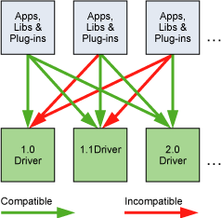
Backward and Forward Compatibility
If something is backward compatible, it will work with previous versions of the software
If something is forward compatible, it will work with future versions of the software
Notes:
In the picture you can see the example of backward and Forward compatibility.
Applications, libraries and plugins on the left most side are compatible with all the drivers.
Applications, libraries and plugins in the middle are not backward compatible means not compatible with driver 1.0. however it is compatible with current driver that is driver 1.1 and also with future driver that is driver 2.0
Application, libraries and plugins on the right most side are only compatible with its current version that is driver 2.0. It is not backward compatible and future compatibilities are also not considered for these applications, libraries and plugins.

Slide 13
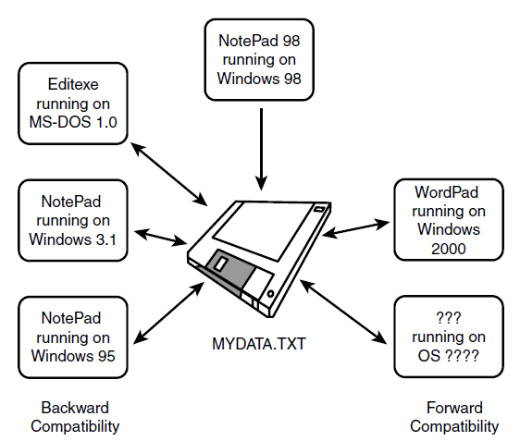
Backward and Forward Compatibility Example
Notes:
This is another example of Backward and Forward compatibility.
Here in this picture, MyDATA.TXT is compatible with its current windows operating system that is windows 98 and Word processor that is NotePad 98. It is compatible with previous operating systems and word processors. It is also future compatible with wordPad running on windows 2000 and above versions

Slide 14
Impact of Testing Multiple Versions
Testing that multiple versions of platforms and software applications work properly with each other is a huge task
Example: you have to do compatibility test of a new version of operating system
Programmer has fixed numerous bugs, improved performance and added many new features
There can be hundreds or thousands of existing programs for the current version of OS
The projects goal is to be 100 percent compatible with them
Notes:
You can see the pictorial representation of the example in the next slide

Slide 15
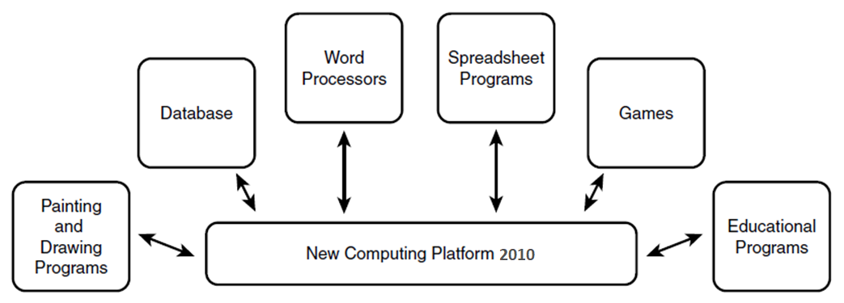
Impact of Testing Multiple Versions
Notes:
In this picture you can see the ‘New Computing Platform 2010’. Multiple programs running on the previous OS should be compatibility tested on this platform like
Painting and Drawing Programs
Databases
Word Processors
Spreadsheet Programs
Games
Educational Programs and many more
Here we are not talking about the versions of the platform and applications

Slide 16
Impact of Testing Multiple Versions
Ways to Reduce the Testing Effort
Equivalence Partitioning
Select Important Programs
Popularity
Age
Type
Manufacturer
Notes:
There are so many applications available with a number of versions but every application and all its versions cannot be considered for compatibility testing. Because it will take a lot of time and effort.
Ways to reduce the testing effort are:
Equivalence Partitioning
Select Important Programs
There are multiple criteria to select important programs. These include:
Popularity-
For example: You can use sales data to select the top 100 or 1000 most popular programs
Age-
For example: You might want to select programs and versions that are less than three years old
Type-
Break the software into types such as
Painting Software
Word Processors
Accounting Software
Database Software
Communications Software and so on
Select software from each category for testing
Manufacturer- Pick software based on the company that created it

Slide 17
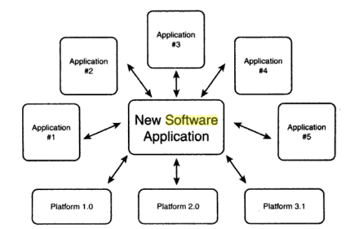
Impact of Testing Multiple Versions
Notes:
Here in this picture you can see a New Software Application that should be compatible with thses shortlisted platforms and many other already developed applications.

Slide 18
Standards and Guidelines
Levels of Standards and Guidelines
High Level-
In which you guide your product’s
General Operations
Look and Feel
Supported Features etc.
Low Level-
Include nitty-gritty details, such as
File Formats
Network Communication Protocols etc.
Notes:
Now we will cover our question number 3 that is
What compatibility standards or guidelines should be followed that define how your software interact with other software?
So there are two levels of standards and guidelines.
High Level and Low Level

Slide 19
High Level Standards
Consider the following questions to get information regarding the required platforms of a software to run
Will your software run under Windows, Mac or Linux operating system?
Is it a Web Application? If so, what browsers will it run on?
Each of these have their own set of standards and guidelines that must be followed to claim that it’s compatible with the platform
Notes:
For example to make you software windows compatible, you will have to follow the standards and guidelines provided by windows for the software to run under windows OS.

Slide 20
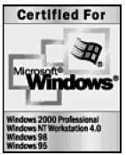
High Level Standards
Certified for Microsoft Windows Logo signifies that the software meets all the criteria defined by the guidelines
Software must pass compatibility testing by independent laboratory
The goal is to assure that the software runs stably and reliably on OS
A few examples of the logo requirements are that the software
Supports mice with more then three buttons
Supports installation on the disk drives other than C: and D:
Supports file names longer than the DOS 8.3 format (name of eight characters and up to a three character extension)
Does not read, write or otherwise use the old system files win.ini, system.ini, autoexec.bat, or config.sys
These are only four items out of a 100+ page document
Notes:
Here is another example of High level standards

Slide 21
Low Level Standards
These standards are considered for granted
These standards should be treated as extensions to software’s specifications
The tester needs to find the standards for formats and design to confirm that the software meets the standards and guidelines
Example: Software specification states:
The software will save and load its graphics files as .bmp, .jpg and .gif formats
You need to find the standards for these formats and design tests to confirm that the software does indeed adhere to them
Low level standards are more important than high level standards

Slide 22
Low Level Standards
Example1: You create a program that
Runs on windows
Does not have look and feel of windows software
Will not be Certified for Microsoft Windows logo because it does not follow high level standards
Users might not be thrilled with the differences from the other applications , but they could use the product.
Example 2: You create a graphics program that saves its file to disk as .pict files (Macintosh Standard file format for graphics)
Program does not follow the standards for .pict files
Your user will not be able to open the file in any other program
The software would likely be a short lived product
Communication protocols, programming languages syntax and any other means used by programs must adhere to published standards and guidelines
Notes:
Does not have look and feel of windows software
For example: In windows, the menu bar and tool bar are aligned at the top left side of the window. But if in a program the menu bar and tool bar are aligned at the top right side, the user will notice the difference but he may use the program and ignore it.
In this case the program has followed low level standards but not the high level standard.
The software would likely be a short lived product
It means if we do not follow the high level standard the user still can use the system but if we do not follow low level standards the project will be short lived.

Slide 23
Data Sharing Compatibility
A software adhering to standards allows users to easily transfer data to and from other software is a great compatible product
The most familiar means of transferring data from one program to another is saving and loading disk files
Adherence to standards for the disk and file formats makes this sharing possible
Data Sharing Possibilities
File Save and File Load
File Export and File Import
Cut, Copy and Paste
Dynamic Data Exchange
Notes:
Now we will cover the question number 4 that is
What types of data will your software use to interact and share information with other platforms and software?

Slide 24
Data Sharing Compatibility
File Save and File Load- You save data on a disk and hand carry it over to another computer running different software and load in it
The data format of the files needs to meet standards for it to be compatible on both computers
File Export and File Import- are the means that many programs use to be compatible with older versions of themselves and with other programs
To test the import feature, you need to create test documents in each compatible file format
Those documents would have equivalence partitioned samples of the possible text and formatting to check that the importing code properly converts it to the new format
Notes:
File Save and File Load- For Example: You copy a Microsoft world file and paste it in USB from your computer and then copy from usb and paste it into another computer that has only Wordpad. The file to open in Wordpad, it should be compatible with it. It should meet the standards of Wordpad.
File Export and File Import- For Example: When you export database file from Wamp server, you have multiple options of file format in which you can export. If you export it as .txt file it should be opened properly in word processor along with information of joins.

Slide 25
Data Sharing Compatibility
Cut, Copy and Paste- are most familiar methods for sharing data without transferring data to disk
In this case, the transfer happens in memory through an intermediate program called clipboard
The clipboard is designed to hold several different data types such as text, pictures and sounds
Whenever a user performs a cut or copy, the data is placed in the clipboard. When he does a paste, it’s copied from clipboard to destination software
During testing, make sure that data can be properly copied in and out of the clipboard to other programs

Slide 26
Data Sharing Compatibility
DDE (Dynamic Data Exchange)- is a method of inter-process communication under Microsoft Windows. It allows one program to subscribe to items made available by another program
The difference between DDE and clipboard is that with DDE data can flow from one application to other in real time.
Cutting and copying is a manual operation. With DDE transfer can happen automatically
Notes:
Example- is a written report in a word processor that has pie chart created by a spreadsheet program.
If it is copied and pasted in the report, it would be a snapshot in time of the data.
If the author linked the pie chart into the report as an object, when the underlying numbers for the chart change, the new graphics will automatically appear in the report

